Slide 1
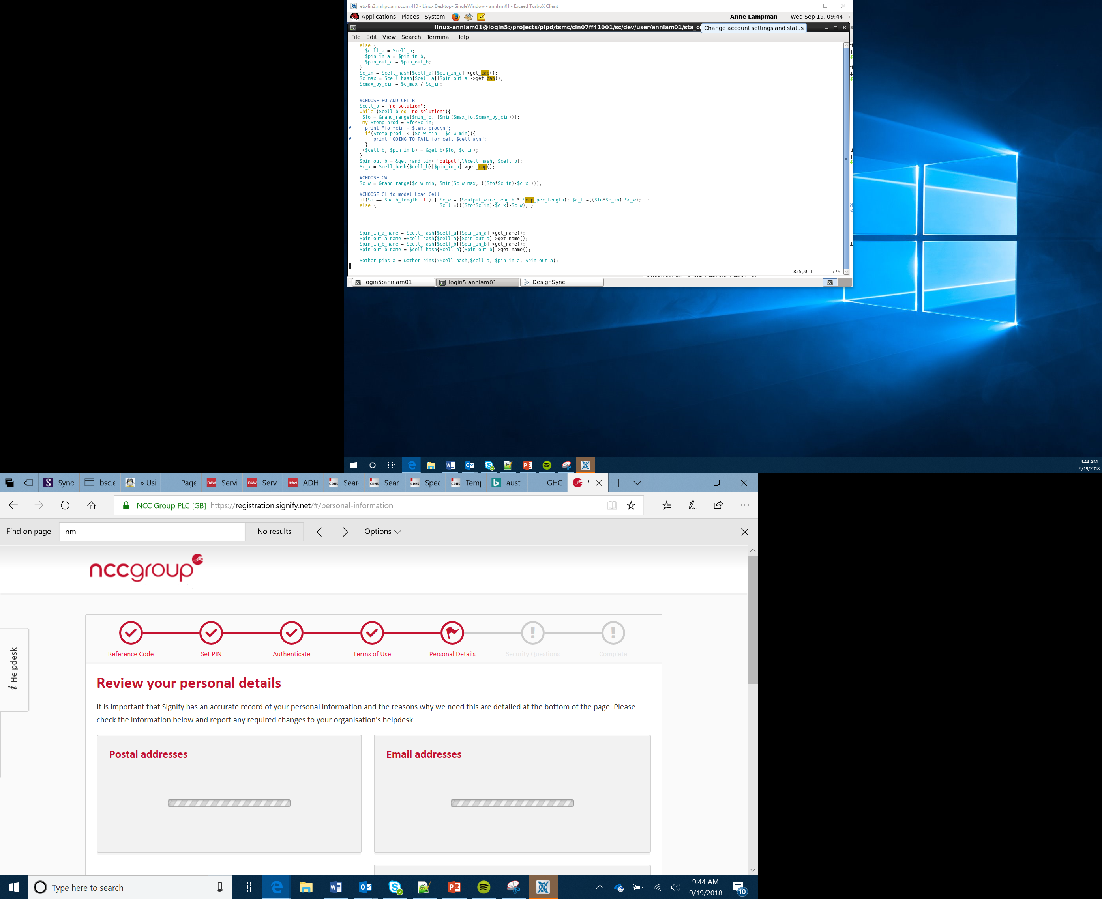

Representing Sound
Lesson 18

Slide 2
Analog Sound Wave
Analog sounds are continuous sounds. In order for a computer to be able to process them they must be sampled into discrete digital values. This involves taking measurements at set time intervals and storing the height of the wave at that moment in time

Slide 3
Sampling an analog sound
When an analog sound is sampled measurements are taken at set periods of time
The number of samples that are taken within a specific period of time (usually a second) is measured in Hz
The resolution is the number of bits which are used to measure each sample
Notes:
This takes the previous analog sound wave and adds an axis for the time and resolution. Students may start to see it as a graph.

Slide 4
Sampling an analog sound
If we were to take one sample per time period this would give us a sound file that doesn’t match the original sound very well. This would result in it sounding relatively poor quality
Only the very top and bottom of each wave would be measured
As very few samples are taken very little data needs to be stored which would result in a small file

Slide 5
Increasing the quality of the sound file
If we doubled the number of samples that are taken the file size would also double. This would however result in a file which more closely matches the original analog sound wave

Slide 6
Increasing the quality of the sound file (2)
If the sample rate were increased again the file would closely match the original. MP3 files have a sample rate of 44.1KHz which means that 44,100 samples are taken per second
Notes:
Now that students have an understanding of how an analog sound file is generated they should try to create their own using the sound worksheet.

Slide 7
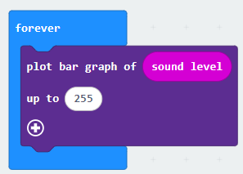
Creating a sound level monitor
The built-in microphone on the micro:bit V2 can be used to monitor volume levels
The sound level will be output on the LED screen on the micro:bit

Slide 8
Summary
Analog sounds are continuous
In order for a computer to be able to store and process them they must be converted into a digital format
A number of discrete samples are taken. The number of samples taken within a given period of time is called the sample rate. It is measured in Hz
The more samples that are taken per second the closer the file will match the original sound. As more samples are taken the file size gets larger

